Slide 1

Ray Tracing
Scott Chatham

Slide 2


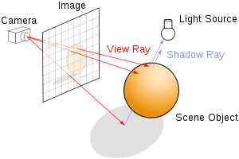

What is it?
Follows rays of light and simulates interactions with objects to determine color
Can create more realistic images, but at greater cost
Works on a pixel by pixel basis instead of vertex by vertex

Slide 3
How does it work?
Create your scene
For each pixel in our viewport, cast a ray and find its intersection
Stopping here would produce a result much like that of the pipeline renderer we’ve been using
Ray tracing can do more...

Slide 4
Recursive Ray Tracing
Once a ray intersects with an object, we can cast additional rays from that point to get more information
Shadow rays
Reflected rays
Transmitted rays

Slide 5
That seems slow...
Using a naive approach, each ray has to check intersection against every object in the scene
This gets even worse when we cast rays for each intersection
Things we can do to help:
Bounding volumes
Acceleration structures

